Slide 1

“Prospects for the Electric Vehicle Market and Business opportunities with special reference to SE Europe and Greece”
Connected Cars - Conference
Anais Club, Varibobi
24 October 2018
Presentation by: Mr. Alexandros Perellis,
Research Associate, IENE
INSTITUTE OF ENERGY
FOR SOUTH EAST EUROPE

Slide 2
Advantages and Disadvantages of EVs
Advantages
Tailpipe emission-free
Decarbonization of on-road transport when deployment is coupled with high RES penetration
Air pollution reduction and decentralization
Engine Noise pollution-free
High Efficiency: EVs use more than 75% of the energy to run the vehicle (81% of the energy stored in the battery is transformed into mechanical energy)
The low operation cost due to the low cost of electricity in comparison to petrol
The low maintenance cost resulting from the lower amount of moving parts.
Disadvantages
Τhe limited driving range,
The lack of publicly available charging infrastructure,
The charging time which is spanning from (1 to 40 hours),
The high acquisition cost of EVs

Slide 3
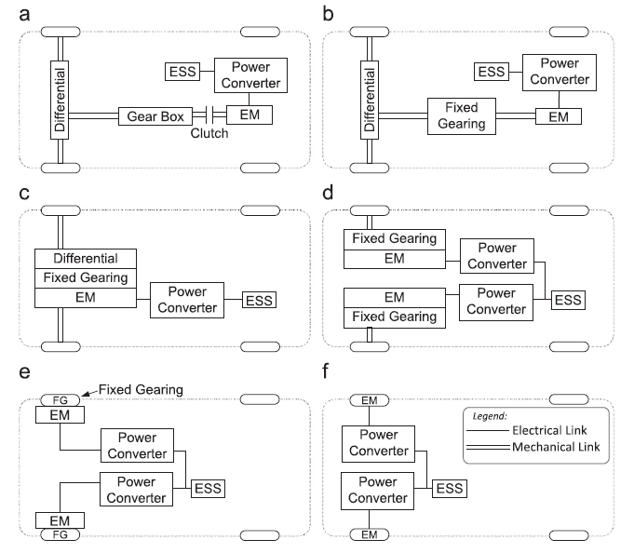
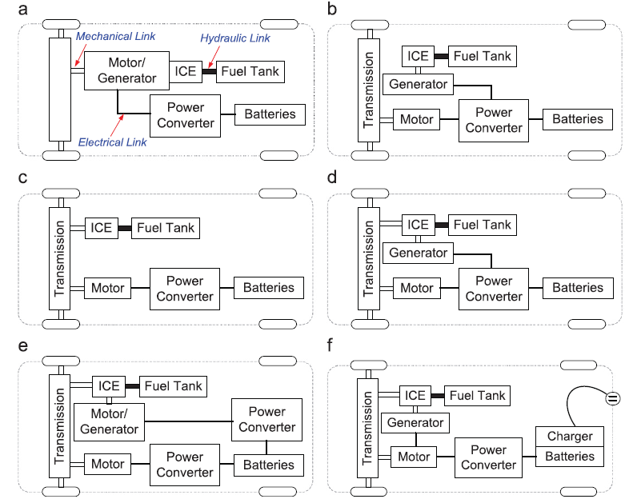
EV Drivetrains
BEVs
PHEVs
Source:Tie et al.
Driving experience
Weight minimization
Torque performance
Energy Efficiency / Energy Management
Fuel economy
Electric driving range

Slide 4
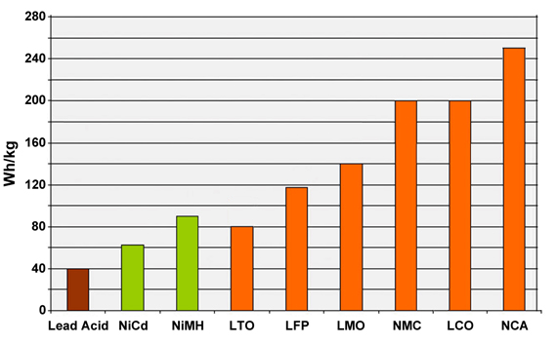
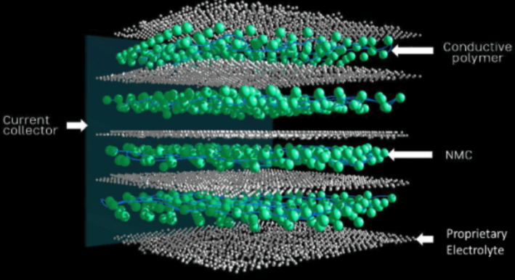
Battery Technology
Cathode material : Metal oxide that can release more Lithium-ions during each charge operation. competitive oxidation capabilities, high cell voltage induced capacities
Lithium cobalt oxide (LCO), lithium nickel cobalt manganese oxide (NMC), nickel cobalt aluminum oxide (NCA), lithium manganese oxide (LMO), or lithium iron phosphate (LFP)
The electrolytes: solvent with high oxidation potential - enable the use of high-voltage cathodes -increase significantly the battery’s specific energy.
Battery cell technology transition from the proven lithium manganese oxide (LiMn2O4) with a blend of lithium Nickel Manganese Cobalt Oxide (LiNiMnCoO2) prismatic battery pack towards Lithium Nickel Cobalt Aluminum Oxide (LiNiCoAIO2) provides significant development in energy efficiency as it provides specific energy of 3.4Ah per cell or 224Wh/kg.
Solid –state batteries : Low power-density and high-energy

Slide 5
Energy Efficiency and New Vehicle Technologies
Reduction of the weight of a passenger car of 10% can lead to decrease in energy requirement of 6-7%.
Battery pack – Battery cell capacity improvement. Energy density increase – vehicle weight reduction. (200 - 250Wh/kg).
Regenerative breaking. Control strategies (algorithm development, user experience data-mining)
Autonomous driving technology (assisted-driving technologies)
(a) Camera over radar, (b) Radar over camera and. (c) hybrid approach (light detection, radar, camera systems, sensor-fusion algorithms). Machine learning – training of AD system through user experience (use of BIG-data)

Slide 6
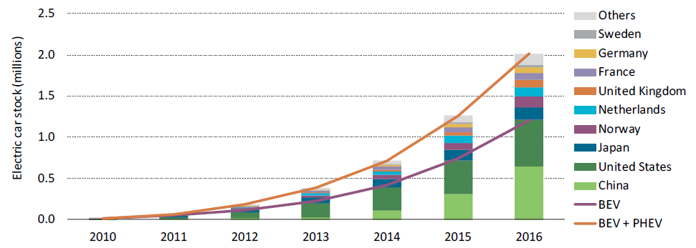
EV Market
Figure 18 The Evolution of the global electric car stock, 2010-2016 (source: IEA)
Globally the EV sales showed growth of 40% in 2016. The growth declined from 70% in 2015
In 2016 the global sales of plug in electric vehicles reached 753,000, 60% of which were battery-electric vehicles (BEVs)
The main barriers that dictate the EV market penetration the technical limitation of EVs and charging infrastructure (driving range, charging time, availability of publicly available charging stations, ownership cost, communication lack of support policies)
The main driver for market success: (a) support policies, aiming at lowering the cost of acquisition and ownership of EVs or provide driving privileges to EV owners, (b) polices that aim at the automakers by incentivizing the research and development (R&D) of EV technologies to promote economies of scale.

Slide 7
EV Battery Cost Formulation (i)
Price drop which reached to 73% in the period 2010-2016 - Decreasing manufacturing (economies of scale)
Average battery cost in 2016 was reached 250-270 USD/kWh while the most efficient manufacturers, namely GM and Tesla achieved prices of 180-200 USD/kWh.
Cost efficiency in battery manufacturing is heavily influenced by volume of production and the size of battery pack. (200,000 units/year – cost 200USD/kWh) , (300 USD/kWh for production 10,000 - 30,000 (2015).
Scaling up production of 3GWh/year will lead to annual battery price reduction of 2.5%. 2017 Scaling up of 10GWh, 344.5GWh planned production for 2021
Increasing of the battery pack size from 60 kWh to 100kWh can potentially lead to manufacturing cost reduction of 17% per kWh.
Prices well below $100/kWh achieved between 2020-2022, projection for average battery cost point to similar prices by the mid-late 2020s, ($73/kWh in 2030)
Lithium and Cobalt are the minerals that are crucial for current battery price formulation: Cobalt more scarce with higher leverage of 4.3% increase per doubling of its price

Slide 8
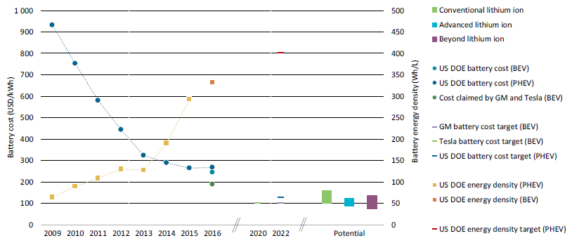
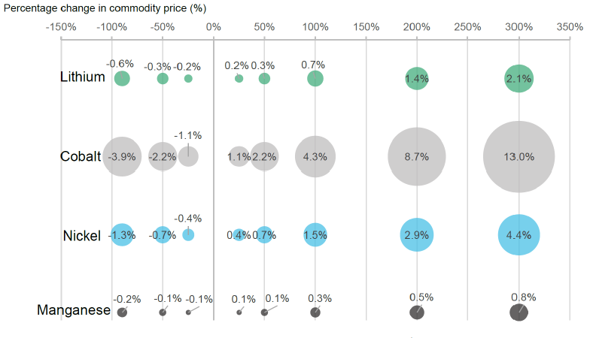
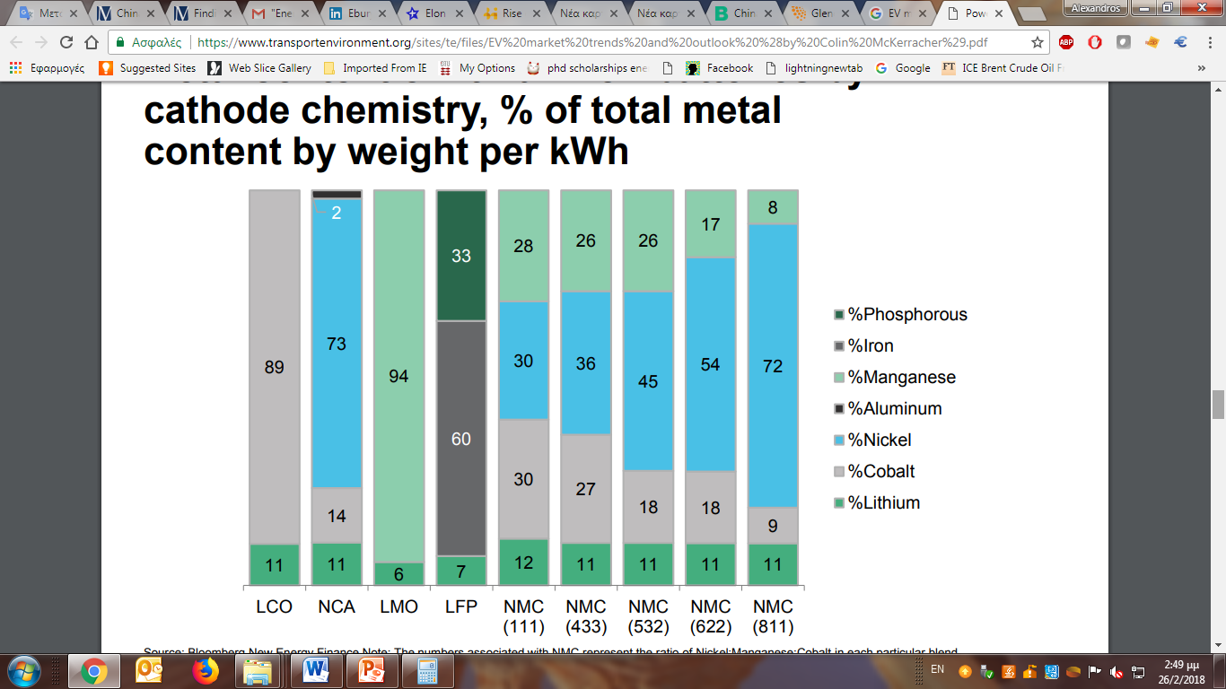
EV Battery Cost Formulation (ii)
Figure 19 Updated assessment of battery cost developments (source: IEA 2017 ).
Figure 29 Impact of raw material price fluctuations on NMC (111) battery pack costs (%) (source: BNEF 2017)
Metal content of lithium-ion batteries by cathode chemistry, % of total metal content by weight per kWh (Source: BNEF)

Slide 9
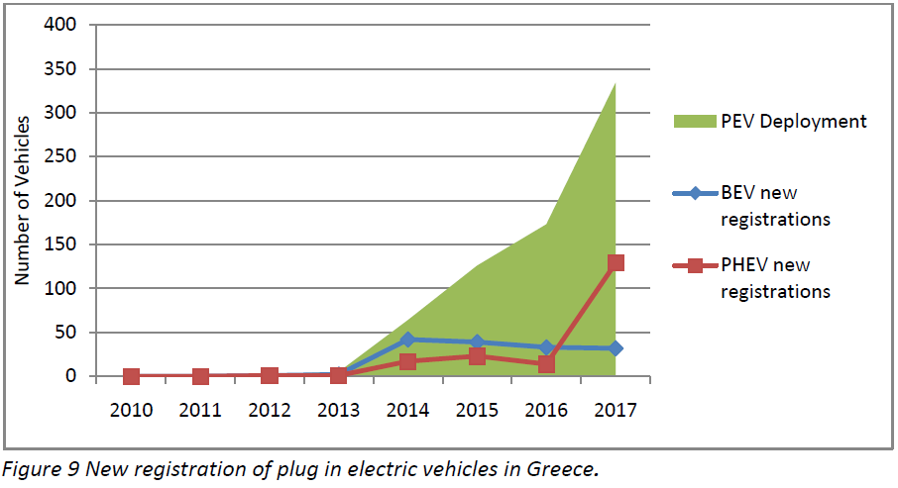
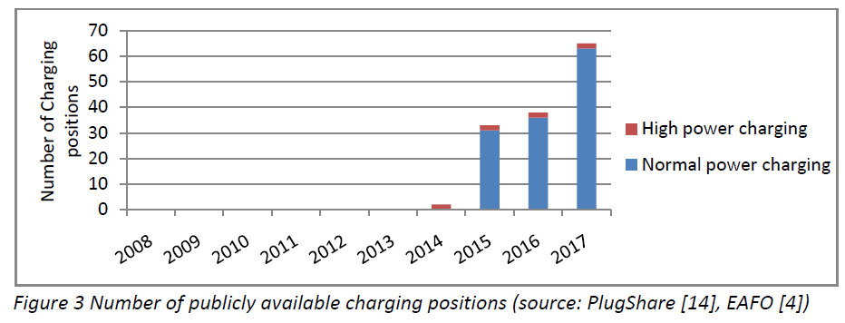
Greek EV Market
2017 EV market share increased from 0.06% to 0.19 % with the market almost tripling in volume, (market growth of +243%)
Turn of the consumers towards PHEVs which accounted for 80.1% of the total sales (+821%).
German OEMs, namely BMW dictating the market.
No trends can be observed in Greek EV market
No market initiation due to lack of fiscal incentives and charging infrastructure
  EU average 6.7 vehicles/charging position (2017)
EU EV Market observations showed that strong fiscal incentives and deployment of charging infrastructure is responsible for the EV deployment

Slide 10
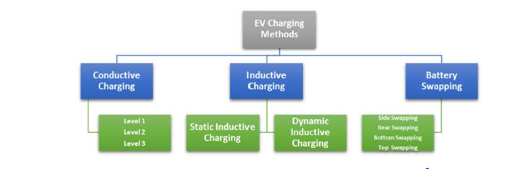
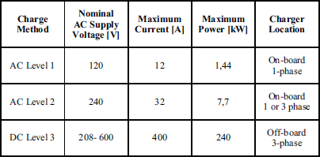
EV Charging
TABLE 11 Electrical Ratings of Different Charge Method in North America (Source: SAE)
Charging Modes For Conductive Charging (IEC)
Mode 1: Uncontrolled AC charging utilizing a 1 or 3 phase circuit and socket (250V 1-phase or 480V 3-phase). (16 A and 11 kW)
Mode 2 Uncontrolled AC charging utilizing a 1 or 3 phase circuit and socket (250V 1-phase or 480V 3-phase). (32 A and22 kW).
Mode 3: controlled, Slow or semi-quick AC charging utilizing 1 or 3 phase circuit, (Max current/power: 63 A and 43.5 kW)
Mode 4: Controlled, fast DC charging (Max. power/current supply 38 kW/400A and 170kW/1000V (Fast charging R&D projects with liquid coolant utilization

Slide 11

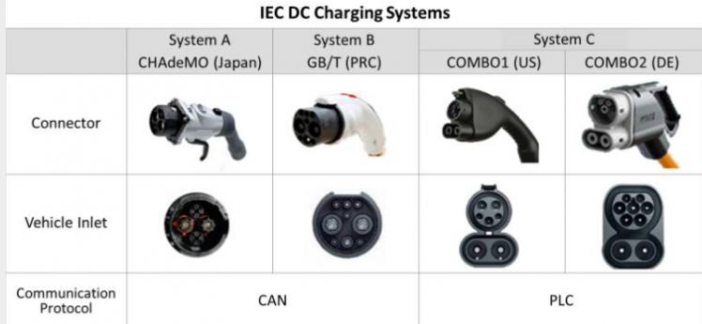
Charging Connectors
Type 1, 2, 3, 4 connectors
Standardization Interoperability
Communication protocol (SAE)
Figure 74 Charging systems illustration (Source: IEC)

Slide 12
The Impact on Power Generation to the Grid
Harmonic Distortion and Power quality
Research showed that the primary limitation of the number of fast chargers/vehicles in a cluster is not the power capacity of the upstream power transformers, but the harmonic limits for electricity pollution, pointing limitation of TDD rather than THD.
Voltage Drops and Power losses
Typical charging load is between 10 to 30 kW (Charge mode 2) - might result in congestion in simultaneous charging.
Impact to the transformers operation and their lifetime reduction
Significant increase in peak loads – more power generating capacity needed.
Solutions - Smart Charging
Mitigation of the impact to grid and power generation can be achieved by smart charging (temporal/spatial charging load allocation)
  Centralized Charging Control
  Decentralize Charging Control

Slide 14
Greece - On-road Transport CO2 Emissions
Shrinking of private transportation activities of the Greek population to 9,723 km/year in 2015.(calculated on the basis of total petrol (gasoline) consumption for 2015)
The passenger car fleet of Greece is one of the oldest in Europe, according to ACEA, numbering more than 3.5 million cars which are more than 10 years in circulation
The number of light duty passenger vehicles registered, which meet the emissions target of 95g CO2/km for 2021, has been 71,260 in the period 2010-2016 accounting for the total 12.3% of the total cars registered in the same period

Slide 15
Greece - CO2 Emission Reduction Scenarios
 | Petrol Passenger Cars | Diesel Passenger Cars | Units
Annual Consumption / vehicle | 671.9762 | 498.563 ² | Liters
Combustion CO₂ Emissions / liter¹ | 2.39 | 2.67 | CO₂ kg/l
Annual CO₂ Emissions / vehicle | 1606.023 | 1331.163 | CO₂ kg
Total passenger fleet emissions | 7.939 | 0.218 | Mt COeq
 |  | Number of EVs introduced |  |  | Units
Scenario | Reference | 10000 | 100000 | 1000000 | EVs
Average CO₂ emissions per km | 164.29 | 163.91 | 160.56 | 128.29 | CO₂ g / km
Total Fleet Tailpipe CO₂ emissions | 8.16 | 8.14 | 7.97 | 6.37 | Mt CO₂eq/y
CO₂ Tailpipe Emissions' Reduction (%) | 0 | 0.2% | 2.3% | 21.9% | %
Total Indirect Emissions of EV segment of the passenger car fleet | 0.02 | 7.70 | 76.96 | 769.60 | kt CO₂eq/y
Total fleet emissions | 8.16 | 8.15 | 8.05 | 7.14 | Mt CO₂eq/y
CO₂ Total Emissions' Reduction (%) | 0% | 0.1% | 1.3% | 12.5% | %
The total emission resulting from the use of passenger cars are estimated to be 8.16 million tons of CO₂ equivalent, (48.9% of transport activity, 2015)
Substituting the older segment of the passenger car fleet with EVs:
  Tailpipe emissions of the total country’s fleet to reduce about 2.3% of tailpipe emission reduction (0.17 MtCO₂eq) for substitution of the 100 thousand most carbon intensive cars with EVs, while substituting the 1 million most carbon intensive passenger Cars with EVs will result to 21.9% of tailpipe emissions

Slide 16
Decarbonization of Greece’s On-road
Transport and Indirect On-road Carbon Emissions
Greece’s power sector is one of the most carbon intensive ones among IEA (582 grams of CO₂ per kWh produced in 2015)
Average IEA countries 390 gCO2 per kWh in 2015.
Effect of EV technology on the indirect on road carbon emissions (technology focuses: driving range or energy efficiency)

Slide 17
EVs & Economic Repercussions
Markets segments associated with ICE Engines, transmission systems, fuel systems, exhaust, forging components and small general parts manufacturing are expected to be negatively affected by the transition to gearless, fuel-less, robust new vehicles.
Wiring, electric component development, electronic architecture systems and components and telematics are expected to attract new investors and expand their activity.
Moreover the RES and electricity distribution industry is expected to be driven by electric mobility acceleration in the future
  New power generation capacity installation
  grid enhancement to facilitate “green” power to the electrified on-road transport.
Additional infrastructure investment (charging stations, power distribution network expansion, smart grid appliances)
Higher general consumer spending because of the substantially lower running costs of electric cars over their lifetime (which more than offset their higher purchase price.)
Substitution of the sectorial activity of oil production and distribution which has very low employment intensity of just 4 jobs per 1 million euros.
Any shift in expenditure from buying imported oil to other expenditure choices creates employment
The claimed loss in excise revenues for Governments is simply replaced by higher tax revenues in other economic sectors.

Slide 18
IENE’s Current Endeavors in Regards to EV Market Research
Periodical issue of IENE - Newsletter “Electric mobility update”
Research on: “Sensitivity Analysis of the Projected Power Demand for Uncoordinated EV Charging in Greece”

Slide 19
Sensitivity Analysis of the Projected Power Demand for Uncoordinated EV Charging in Greece”
Uncoordinated EV Charging
Higher peak load demand
Grid instability (grid/branch congestion/ voltage drops)
  Introduction of new
  For the enhancement of the flexibility of the power system the identification of charging behavior is required.
EV charging – uncontrollable on the will of the consumer
The use of Smart metering applications on charging points is is limited
Charging load is not being represented in the electricity market (day-ahead, intraday, balancing market)
EV charging loads are not flexible
EV charging scenario: as soon as the vehicle is idle
Main Parameters
Number of circulating EVs – Introduction rate of EVs in the market
  Grid power capacity - capability
  Availability of publicly accessible charging infrastructure
  Driving Range (Electricity storage capability – battery capacity)
  Policies and incentives for the support of electric mobility
Average use of EVs (average yearly mileage)
  41,000 - 69,3801 km/year at 2009 -> 9,723 km/year at 2015
Electricity Consumption of available EV technology
  Consumption differentiation. Two approaches by OEMs (a) energy efficiency, (b) driving range. Reference scenario 0.156kWh/km
  Driving patterns: Charging pattern based on immediate charging when idle (energy and power demand profiles)
The average charging rate – power availability for charging
  7.4kW / 11kW/ 22kW
  Fast charging >=50kW (CCS / CHadeMO)
  Liquid-cooled DC charging 250 – 350 kW

Slide 20
Scenarios of EV Market Penetration in Greece
Scenario 1
Recovery of the Automotive Market
2030: 80,000 EVs, 2040: 900,000 EVs
Conservative market penetration of EVs (average market penetration of 5% for the period 2018 - 2030)
Sufficient coverage of charging need by the publicly available charging network
Scenario 2
Stabilization of motor vehicle market at 100,000 sales per annum
Average EV penetration in them motor vehicle of 15% for the period 2018-2030
2030: 200,000 EVs , 2040: 1.1 mil. EVs

Slide 21
Comparison of Uncoordinated Charging with
PEV Charging Scheduling
Indicative scenario: 500,000 EVs , average PEV charging rate of 22kW (mennekes mode 2, 3 phazes 32Α), use: 19.4 thousand km/annum (2015 Χ 2)
236.95 MWh difference in peak electricity demand
Coordinated charging: Power demand refers to non EV charging related power demand
Synchronization of charging loads of 75% could potentially result in peak load intra-hour demand of 1.65 GW (in weekly critical hour)

Slide 22
Power Demand for Uncoordinated EV Charging
Peak EV-Charging power demand 250kW , 50% charging synchronization -2030
Peak EV-Charging power demand 250kW , 25% charging synchronization -2030
Annual max peak load of the power system of Greece for 2017
Peak EV-Charging power demand 22kW , 25% charging synchronization -2040
2032: 4900MW maximum annual power demand at 250 kW with simultaneous charging of 25% of the vehicles during the yearly critical EV-charging load hour (392 thousand EVs)
2040: 2500MW maximum annual power demand at 22 kW with simultaneous charging of 25% of the vehicles during the yearly critical EV-charging load hour (1.11 mil. EVs)
Importance of automations of timely allocation of charging loads (smart metering) or the actions of PEV aggregators with authority to control/regulate the charging activity (scheduling, charging rate (power), etc.)

Slide 23

Thank you for your attention
www.iene.eu
Contact:
aperellis@iene.gr
aperellis@gmail.com

